Slide 1
Object-Based Databases
Notes:
1

Slide 2
Object-Based Databases
Complex Data Types and Object Orientation
Structured Data Types and Inheritance in SQL
Table Inheritance
Array and Multiset Types in SQL
Object Identity and Reference Types in SQL
Implementing O-R Features
Comparison of Object-Oriented and Object-Relational Databases
Notes:
2

Slide 3
Object-Relational Data Models
Extend the relational data model by including object orientation and constructs to deal with added data types.
Allow attributes of tuples to have complex types, including non-atomic values such as nested relations.
Preserve relational foundations, in particular the declarative access to data, while extending modeling power.
Upward compatibility with existing relational languages.
Notes:
3

Slide 4
Complex Data Types
Motivation:
Permit non-atomic domains (atomic ≡ indivisible)
Example of non-atomic domain: set of integers,or set of tuples
Allows more intuitive modeling for applications with complex data
Intuitive definition:
allow relations whenever we allow atomic (scalar) values — relations within relations
Retains mathematical foundation of relational model
Violates first normal form.
Notes:
4

Slide 5
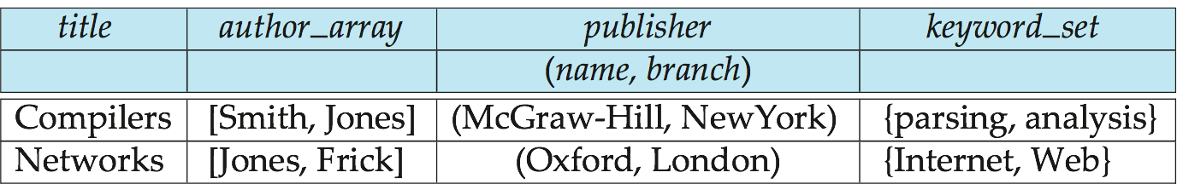
Example of a Nested Relation
Example: library information system
Each book has
title,
a list (array) of authors,
Publisher, with subfields name and branch, and
a set of keywords
Non-1NF relation books
Notes:
5

Slide 6
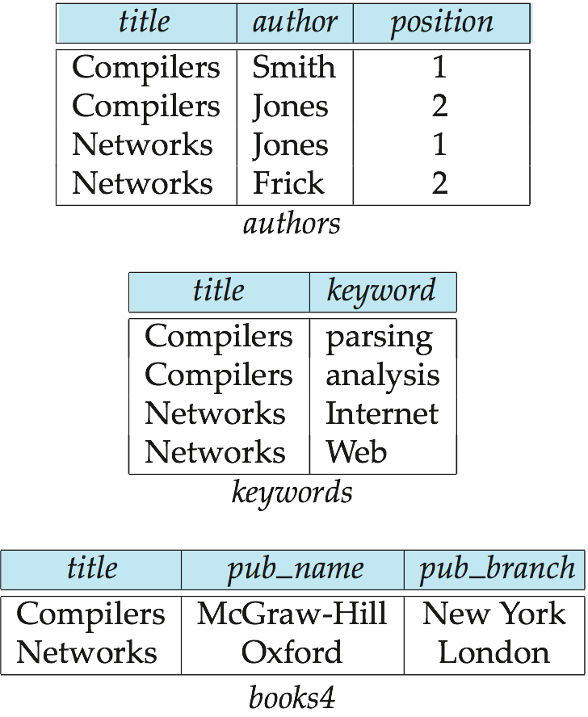
4NF Decomposition of Nested Relation
Suppose for simplicity that title uniquely identifies a book
In real world ISBN is a unique identifier
Decompose books into 4NF using the schemas:
(title, author, position )
(title, keyword )
(title, pub-name, pub-branch )
4NF design requires users to include joins in their queries.
Notes:
6

Slide 7
Complex Types and SQL
Extensions introduced in SQL:1999 to support complex types:
Collection and large object types
Nested relations are an example of collection types
Structured types
Nested record structures like composite attributes
Inheritance
Object orientation
Including object identifiers and references
Not fully implemented in any database system currently
But some features are present in each of the major commercial database systems
Read the manual of your database system to see what it supports
Notes:
7

Slide 8
Structured Types and Inheritance in SQL
Structured types (a.k.a. user-defined types) can be declared and used in SQL
create type Name as (firstname varchar(20), lastname varchar(20)) final
create type Address as (street varchar(20), city varchar(20), zipcode varchar(20))
not final
Note: final and not final indicate whether subtypes can be created
Structured types can be used to create tables with composite attributes
create table person (
name Name,
address Address,
dateOfBirth date)
Dot notation used to reference components: name.firstname
Notes:
8

Slide 9
Structured Types (cont.)
User-defined row types
create type CustomerType as ( name Name, address Address, dateOfBirth date) not final
Can then create a table whose rows are a user-defined type create table customer of CustomerType
Alternative using unnamed row types.
create table customer_r(
name row(firstname varchar(20),
lastname varchar(20)),
address row(street varchar(20),
city varchar(20),
zipcode varchar(20)),
dateOfBirth date)
Notes:
9

Slide 10
Methods
Can add a method declaration with a structured type.
method ageOnDate (onDate date)
returns interval year
Method body is given separately.
create instance method ageOnDate (onDate date)
returns interval year
for CustomerType
begin
return onDate - self.dateOfBirth;
end
We can now find the age of each customer:
select name.lastname, ageOnDate (current_date)
from customer
Notes:
10

Slide 11
Constructor Functions
Constructor functions are used to create values of structured types
E.g. create function Name(f_name varchar(20), l_name varchar(20)) returns Name begin set self.firstname = f_name; set self.lastname = l_name; end
To create a value of type Name, we use new Name(‘John’, ‘Smith’)
Normally used in insert statements insert into customer values (new Name(‘John’, ‘Smith), new Address(’20 Main St’, ‘New York’, ‘11001’), date ‘1960-8-22’);
Question:
Define type and create a constructor function Address for Address type.
Insert a tuple using your name and address

Slide 12
Type Inheritance
Suppose that we have the following type definition for people:
create type Person (name Name, address Address)
Using inheritance to define the student and teacher types create type Student under Person (degree varchar(20), department varchar(20)) create type Teacher under Person (salary integer, department varchar(20))
Subtypes can redefine methods by using overriding method in place of method in the method declaration
Notes:
12

Slide 13
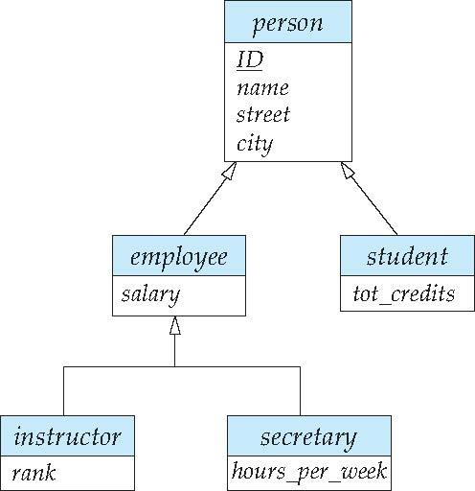
Type Inheritance
Suppose that we have the following type definition for people:
create type Person (name Name, address Address)
Using inheritance to define the student and teacher types create type Student under Person (degree varchar(20), department varchar(20)) create type Teacher under Person (salary integer, department varchar(20))
Question: c. Define type inheritance for the above ERD Specialization
Notes:
13

Slide 14
CREATE OR REPLACE TYPE person_typ AS OBJECT (
idno NUMBER,
name VARCHAR2(30),
phone VARCHAR2(20)) NOT FINAL;
CREATE TYPE student_typ UNDER person_typ (
dept_id NUMBER,
major VARCHAR2(30) NOT FINAL;
CREATE OR REPLACE TYPE employee_typ UNDER person_typ ( emp_id NUMBER,
mgr VARCHAR2(30));
CREATE TYPE part_time_student_typ UNDER student_typ ( number_hours NUMBER);

Slide 15
CREATE TABLE person_obj_table OF person_typ;
INSERT INTO person_obj_table VALUES (person_typ(12, 'Bob Jones', '650-555-0130'));
INSERT INTO person_obj_table VALUES (student_typ(51, 'Joe Lane', '1-650-555-0140', 12, 'HISTORY'));
INSERT INTO person_obj_table VALUES (employee_typ(55, 'Jane Smith', '1-650-555-0144', 100, 'Jennifer Nelson'));
INSERT INTO person_obj_table VALUES (part_time_student_typ(52, 'Kim Patel', '1-650-555-0135', 14, 'PHYSICS', 20));

Slide 16
Oracle Sub-type Example
CREATE OR REPLACE TYPE person_typ AS OBJECT ( idno NUMBER, name VARCHAR2(30), phone VARCHAR2(20)) NOT FINAL;/
CREATE TYPE student_typ UNDER person_typ ( dept_id NUMBER, major VARCHAR2(30)) NOT FINAL; /
CREATE TYPE part_time_student_typ UNDER student_typ ( number_hours NUMBER); /
CREATE TABLE contacts ( contact person_typ, contact_date DATE );
INSERT INTO contacts VALUES (person_typ (12, 'Bob Jones', '650-555-0130'), '24 Jun 2003' );
INSERT INTO contacts VALUES (student_typ(51, 'Joe Lane', '1-650-555-0178', 12, 'HISTORY'), '24 Jun 2003' );
INSERT INTO contacts VALUES (part_time_student_typ(52, 'Kim Patel', '1-650-555-0190', 14, 'PHYSICS', 20), '24 Jun 2003’ );

Slide 17
Table Inheritance
Tables created from subtypes can further be specified as subtables
E.g. create table people of Person; create table students of Student under people; create table teachers of Teacher under people;
Tuples added to a subtable are automatically visible to queries on the supertable
E.g. query on people also sees students and teachers.
Similarly updates/deletes on people also result in updates/deletes on subtables
To override this behaviour, use “only people” in query
Questions:
Insert tuples to people, students and teachers
Find all people who are neither student or teacher

Slide 18
Consistency Requirements for Subtables
Consistency requirements on subtables and supertables.
Each tuple of the supertable (e.g. people) can correspond to at most one tuple in each of the subtables (e.g. students and teachers)
Additional constraint in SQL:1999:
All tuples corresponding to each other (that is, with the same values for inherited attributes) must be derived from one tuple (inserted into one table).
That is, each entity must have a most specific type
We cannot have a tuple in people corresponding to a tuple each in students and teachers
Notes:
18

Slide 19
Array and Multiset Types in SQL
Example of array and multiset declaration:
create type Publisher as (name varchar(20), branch varchar(20)); create type Book as (title varchar(20), author_array varchar(20) array [10], pub_date date, publisher Publisher, keyword-set varchar(20) multiset);
create table books of Book;
Notes:
19

Slide 20
Creation of Collection Values
Array construction
array [‘Silberschatz’,`Korth’,`Sudarshan’]
Multisets
multiset [‘computer’, ‘database’, ‘SQL’]
To create a tuple of the type defined by the books relation: (‘Compilers’, array[`Smith’,`Jones’], new Publisher (`McGraw-Hill’,`New York’), multiset [`parsing’,`analysis’ ])
To insert the preceding tuple into the relation books
insert into books values (‘Compilers’, array[`Smith’,`Jones’], new Publisher (`McGraw-Hill’,`New York’), multiset [`parsing’,`analysis’ ]);
Notes:
20

Slide 21
Type and Table Inheritance Problem
A car-rental company maintains a database for all vehicles in its current
fleet. For all vehicles, it includes the vehicle identification number,
license number, manufacturer, model, date of purchase, and color. Special
data are included for certain types of vehicles:
• Trucks: cargo capacity.
• Sports cars: horsepower, renter age requirement.
• Vans: number of passengers.
• Off-road vehicles: ground clearance, drivetrain (four- or two-wheel
drive).
Construct an SQL schema definition for this database. Use inheritance where appropriate.

Slide 22
Querying Collection-Valued Attributes
create type Publisher as (name varchar(20), branch varchar(20)); create type Book as (title varchar(20), author_array varchar(20) array [10], pub_date date, publisher Publisher, keyword-set varchar(20) multiset);
create table books of Book;
To find all books that have the word “database” as a keyword,
select title from books where ‘database’ in (unnest(keyword-set ))
Notes:
22

Slide 23
Querying Collection-Valued Attributes
create type Publisher as (name varchar(20), branch varchar(20)); create type Book as (ID varchar(10) primary key,
title varchar(20), author_array varchar(20) array [10], pub_date date, publisher Publisher, keyword-set varchar(20) multiset);
create table books of Book;
To find all books that have the word “database” as a keyword,
select title from books where ‘database’ in (unnest(keyword-set ))
Notes:
23

Slide 24
Object-Relational Database Systems
Defining type and creating table using the defined type
Example: Define a type Person with attributes id, name and address. ID is primary key .
User-defined type: Person
create type Person (ID varchar(20) primary key, name varchar(20), address Address) create table people of Person;

Slide 25
Querying Collection-Valued Attributes
create type Publisher as (name varchar(20), branch varchar(20)); create type Book as (ID varchar(10) primary key,
title varchar(20), author_array varchar(20) array [10], pub_date date, publisher Publisher, keyword-set varchar(20) multiset);
create table books of Book;
Query: Find author 1, author 2 and author 3 of book with title `Database System Concepts’
We can access individual elements of an array by using indices
E.g.: If we know that a particular book has three authors, we could write:
select author_array[1], author_array[2], author_array[3] from books where title = `Database System Concepts’
Notes:
25

Slide 26
Querying Collection-Valued Attributes
create type Publisher as (name varchar(20), branch varchar(20)); create type Book as (ID varchar(10) primary key,
title varchar(20), author_array varchar(20) array [10], pub_date date, publisher Publisher, keyword-set varchar(20) multiset);
create table books of Book;
Question:
Write a SQL to find ID, title and keywords of books.
Write a SQL to find ID, title and first author name of books.
To get a relation containing pairs of the form “title, author_name” for each book and each author of the book
select B.title, A.author
from books as B, unnest (B.author_array) as A (author )
Notes:
26

Slide 27
Querying Collection-Valued Attributes
create type Publisher as (name varchar(20), branch varchar(20)); create type Book as (ID varchar(10) primary key,
title varchar(20), author_array varchar(20) array [10], pub_date date, publisher Publisher, keyword-set varchar(20) multiset);
create table books of Book;
Question:
Show the output of the following query for book title ‘Database’ and authors Abid, Marium and Shahid.
To retain ordering information we add a with ordinality clause
select B.title, A.author, A.position
from books as B, unnest (B.author_array) with ordinality as
A (author, position )
Notes:
27

Slide 28
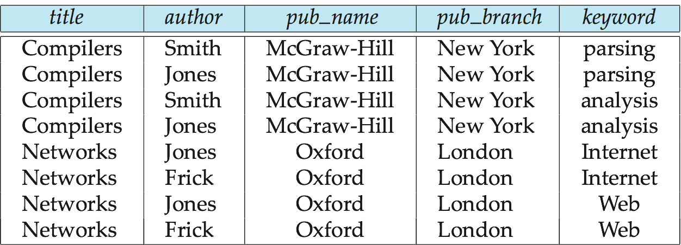
Unnesting
The transformation of a nested relation into a form with fewer (or no) relation-valued attributes called unnesting.
E.g. select title, A.author as author, publisher.name as pub_name, publisher.branch as pub_branch, K.keyword as keyword from books as B, unnest(B.author_array ) as A (author ), unnest (B.keyword_set ) as K (keyword )
Result relation flat_books
Notes:
28

Slide 29
Unnesting
The transformation of a nested relation into a form with fewer (or no) relation-valued attributes called unnesting.
E.g. select title, A.author as author, publisher.name as pub_name, publisher.branch as pub_branch, K.keyword as keyword from books as B, unnest(B.author_array ) as A (author ), unnest (B.keyword_set ) as K (keyword )
Result relation flat_books
Question:
Find the tuples for ‘Database’ book with authors Abid, Marium and Shahid and kyywords ‘ERD’ and ‘RDBMS’
Notes:
29

Slide 30
Reference Types
Creating reference types
create type Person (ID varchar(20) primary key, name varchar(20), address varchar(20)) ref from(ID);
create table people of Person;
A person has id, name and address and reference is ID.
Define the type and create a table people of type Person.
A department has dept-name and head.
Define the type Department and create table departments of type Department.
create type Department ( dept_name varchar(20), head varchar(30))
create table departments of Department
Head is reference type and refer to people table under person
create type Department ( dept_name varchar(20), head ref(Person) scope people); create table departments of Department

Slide 31
Reference Types
A person has id, name and address and reference is ID.
Define the type and create a table people of type Person.
People
ID | Name | Address
2001 | Abid | Mirpur
2002 | Shahid | Bashundhara
A department has dept-name and head.
Define the type Department and create table departments of type Department.
create type Department ( dept_name varchar(20), head ref(Person) scope people); create table departments of Department
Head is reference type and refer to people table under person
Shahid has been appointed as head of the department of ECE.
Insert shahid’s data into department table.
insert into departments values (‘ECE', ‘2002’)
Write SQL statement to find all department name and name of the head.
select dept_name, head->name from departments;

Slide 32
User Generated Identifiers
The type of the object-identifier must be specified as part of the type definition of the referenced table, and
The table definition must specify that the reference is user generated
create type Person (Person_ID varchar(20) primary key, name varchar(20), address varchar(20)) ref from(Person_ID); create table people of Person ref is person_id user generated
When creating a tuple, we must provide a unique value for the identifier:
insert into people (person_id, name, address ) values (‘01284567’, ‘John’, `23 Coyote Run’)
We can then use the identifier value when inserting a tuple into departments
Avoids need for a separate query to retrieve the identifier:
insert into departments values(`CS’, `01284567’)
Notes:
32

Slide 33
Reference Types
Question:
A customer has c-id, name and balance and reference is c-id.
Define the type Customer and create a table cust-info of type Customer.
A purchase has item and purchase-by which is reference type and refer to cust-info table under Customer.
Define the type Customer and Purchase and create table cust and purch of type Customer and Purchase respectively. purchase-by is reference type..
Insert two customers as follows:
Write insert statement to insert one item ‘Watch’ purchased by Atique.
C-id | name | balance
c001 | Rafique | 5000
c002 | Atique | 10000
create type Person (Person_ID varchar(20) primary key, name varchar(20), address varchar(20)) ref from(Person_ID);
reate type Department ( dept_name varchar(20), head ref(Person) scope people); create table departments of Department
item | Purchase-by

Slide 34
Object-Identity and System Generated Reference Types
Define a type Department with a field name and a field head which is a reference to the type Person, with table people as scope:
create type Department ( dept_name varchar (20), head ref (Person) scope people)
We can then create a table departments as follows
create table departments of Department
Referenced table must have an attribute that stores the identifier, called the self-referential attribute
create table people of Person ref is person_id system generated;
Notes:
34

Slide 35
Object-Identity and System Generated Reference Types
Initializing Reference-Typed Values
Question: Make ‘Atique’ as Head of BME department using system generated reference.
To create a tuple with a reference value:
we can first create the tuple with a null reference and
then set the reference separately:
insert into departments
values (`BME’, null)
update departments
set head = (select ref( p)
from people as p
where name = `Atique’)
where dept_name = `BME’
C-id | name | balance
c001 | Rafique | 5000
c002 | Atique | 10000
create type Department ( dept_name varchar (20), head ref (Person) scope people)
Notes:
35

Slide 36
Object-Identity and System Generated Reference Types
Initializing Reference-Typed Values
Question: Make ‘Atique’ as Head of BME department using system generated reference.
To create a tuple with a reference value:
we can first create the tuple with a null reference and
then set the reference separately:
insert into people values (
insert into departments
values (`BME’, null)
update departments
set head = (select ref( p)
from people as p
where name = `Atique’)
where dept_name = `BME’
Question
d. Insert a new department name ‘CE’ and make ‘Fatema’ as head using the system generated reference
Notes:
36

Slide 37
Path Expressions
Find the names and addresses of the heads of all departments:
select head –>name, head –>address from departments
An expression such as “head–>name” is called a path expression
Path expressions help avoid explicit joins
If department head were not a reference, a join of departments with people would be required to get at the address
Makes expressing the query much easier for the user
Notes:
37

Slide 38
Object-Relational Mapping
Object-Relational Mapping (ORM) systems built on top of traditional relational databases
Implementor provides a mapping from objects to relations
Objects are purely transient, no permanent object identity
Objects can be retrieved from database
System uses mapping to fetch relevant data from relations and construct objects
Updated objects are stored back in database by generating corresponding update/insert/delete statements
The Hibernate ORM system is widely used
Provides API to start/end transactions, fetch objects, etc
Provides query language operating direcly on object model
queries translated to SQL
Limitations: overheads, especially for bulk updates

Slide 39
Comparison of O-O and O-R Databases
Relational systems
simple data types, powerful query languages, high protection.
Persistent-programming-language-based OODBs
complex data types, integration with programming language, high performance.
Object-relational systems
complex data types, powerful query languages, high protection.
Object-relational mapping systems
complex data types integrated with programming language, but built as a layer on top of a relational database system
Note: Many real systems blur these boundaries
E.g. persistent programming language built as a wrapper on a relational database offers first two benefits, but may have poor performance.
Notes:
39

